Slide 1

Predicting customer buying behaviour
20/11/2022

Slide 2
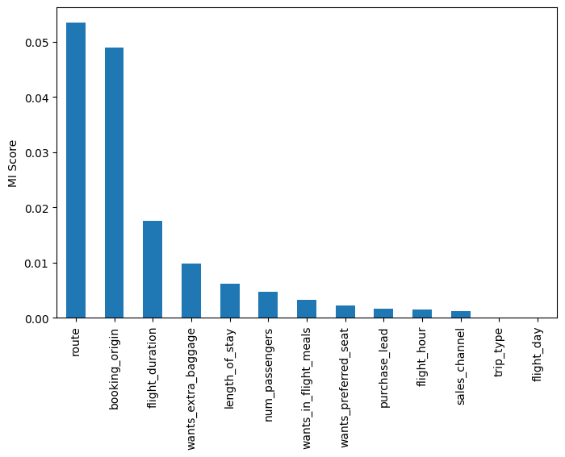
predictive model to understand factors that influence buying behaviour
We have trained the data set with Random forest classifier model and received
ACCURACY: 83.52
AUC score: 0.580
'length_of_stay’
'route’
'booking_origin’
'wants_extra_baggage’
'wants_preferred_seat’
'flight_duration’
are the top features which influence
Customer buying behavior
We need to increase the AUC score.

